Slide 1

CISC 250 – Business Telecomm Networks
Wireless LAN – II

Slide 2
802.11 Security
Attackers can lurk outside your premises
In “war driving,” drive around sniffing out unprotected wireless LANs
http://www.wardrive.net/
https://www.youtube.com/watch?v=w3S7yLGNjNo
https://wigle.net/
In “drive by hacking,” eavesdrop on conversations or mount active attacks
Outside
Attacker
Site with 802.11 WLAN

Slide 3
802.11 Security
There are two main components involved in securing Wireless LANs:
Authorization/Authentication
Open System Authentication: Service Set ID (SSID)
MAC Address Access List
Shared Key Authentication: WEP
802.1x
Encryption
Wired Equivalent Privacy (WEP)
Wireless Protected Access (WPA)

Slide 4
Service Set ID (SSID)
SSID is used to identify an 802.11 network
SSID is broadcasted in Beacon Frames
Beacon Frames are plain text
Use of default SSID, e.g. linksys
Turning off SSID broadcasting makes it tough to locate the network but still the hacker can sniff it from association response frames
Thus SSID is almost no defense against the experienced hacker

Slide 5
MAC Address Access List
Wireless NIC MAC address must be included in the list for the AP to allow data to pass.
Difficult to implement on a large scale or with transient users
Lists need to be maintained in each access point, although querying a centralized list may be possible

Slide 6
Wired Equivalent Privacy (WEP)
Original security solution offered by the IEEE 802.11 standard
Shared key between
Stations
An Access Point
Extended Service Set
All Access Points will have same shared key
No key management
Shared key entered manually into
Stations
Access points
Key management a problem in large wireless LANs

Slide 7
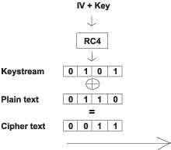
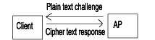
Wired Equivalent Privacy (WEP)
40-bit (64-bit) encryption based on the RC4 algorithm.
104-bit (128-bit) version may be vendor-specific
Keys can be entered in ASCII or Hex, depending on the manufacturer
Security Issue with WEP
Short IV (Initialization Vector): only 24-bit
Static key
Offers very little security at all
https://www.youtube.com/watch?v=sJf1w7kosG8
Shared Key Authentication

Slide 8
802.1x Access Control
A general purpose network access control mechanism
Authentication is done with a RADIUS server, which ”tells” the access point whether access to controlled ports should be allowed or not
AP forces the user into an unauthorized state
user send an EAP (Extensible Authentication Protocol) start message
AP return an EAP message requesting the user’s identity
Identity (e.g., username and password) sent by user is then forwarded to the authentication server by AP
Authentication server authenticate user and return an accept or reject message back to the AP
If accept message is return, the AP changes the client’s state to authorized and normal traffic flows

Slide 9
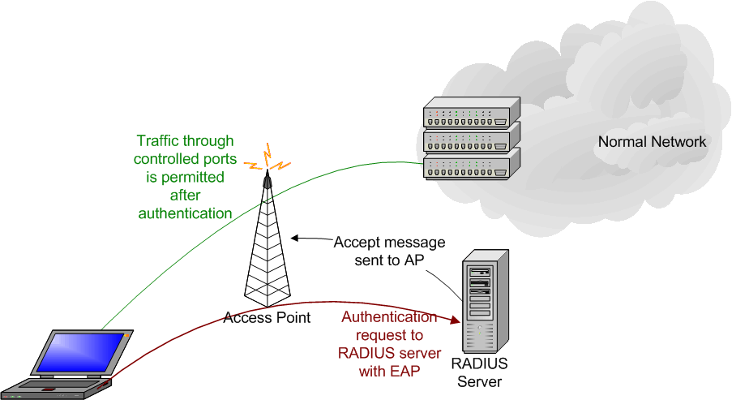
802.1x Access Control

Slide 10
WPA Overview
Wi-Fi Protected Access (WPA)
Security standard developed after WEP’s vulnerabilities had been exposed and successfully attacked
Development was a collaborative effort between the Wi-Fi Alliance and the Institute of Electrical and Electronics Engineers (IEEE)
Purpose was to be an immediate solution while the long-term solution (802.11i/WPA2) was being finished

Slide 11
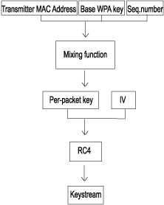
WPA Overview (Cont’d)
WPA strengthened WEP by:
Including authentication using 802.1X framework (commercial/enterprise systems) or a passphrase (home systems)
Password length between 8 and 63 printable ASCII characters
Creating a key hierarchy out of the master key
Doubling the size of the initialization vector (IV) used during encryption
Including a more robust data integrity algorithm (Michael)

Slide 12
WPA Overview (Cont’d)
A session consists of:
Authentication of the client to the access point (802.1X/passphrase)
4-way handshake to exchange key values and generate the key hierarchy
Data session to send encrypted information using the Temporal Key Integrity Protocol (TKIP)
RC4 for encryption
Michael for integrity checking

Slide 13
WPA2 Overview
Wi-Fi Protected Access 2
Security standard developed by the Wi-Fi Alliance and is an implementation of IEEE’s 802.11i
Uses the same authentication process, 4-way handshake, and key hierarchy as WPA
Replaces TKIP with the Advance Encryption Standard (AES) CCMP protocol
AES in Counter-Mode for encryption
AES in Cipher Block Chaining-Message Authentication Code (CBC-MAC) for integrity checking

Slide 14
WPA/WPA2 Attack
Offline Dictionary Attack Overview:
Master key is generated using:
Passphrase and SSID
Session keys are generated using:
Master key, MAC address of client, MAC address of access point, nonce from client, and nonce from access point
Attacker’s goal is to reproduce the key hierarchy to access the network
Attacker needs to capture SSID, MAC addresses, and nonces and perform a dictionary attack to find the passphrase

Slide 15
WPA/WPA2 Attack (Cont’d)
Tool: Kali Linux (previously BackTrack)
How to capture the 4-way handshake?
Enter the monitoring mode
Discover nearby networks and associated clients
MAC addresses, WPA or WPA2, SSID
Disassociate clients to force them to run again 4-way handshake
Use fake disassociation control packets (not protected by IEEE 802.11i)
Record the new 4-way handshake
e.g., using Aireplay
Go home and launch a dictionary attack
Aircrack
Sample Video: https://www.youtube.com/watch?v=kpI3fQjf43E

Slide 16
Securing against the dictionary attacks
To secure your network against these pre-computed dictionaries make sure that
Your SSID is unique (does not appear in the existing tables)
Your password is strong enough (sufficiently long and random :-)
Password length between 8 and 63 printable ASCII characters
Make it at least 13 characters!
No dictionary words!
the longer the better!

Slide 17
Q & A

